Slide 1
Electron Spin - The Stern-Gerlach Experiment
Dr. J P Singh
Associate Professor in Physics
PGGC – 11 Chandigarh

Slide 2
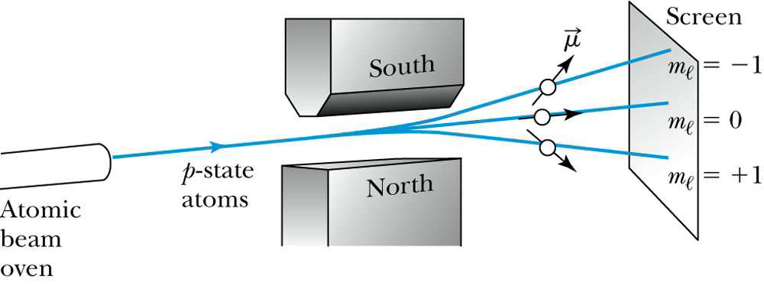
A narrow beam of silver atoms was produced by heating silver in an oven and collimating the atoms that emerged from the oven.
The beam passed through an inhomogeneous magnetic field resulting in a force on the atomic magnetic moments.

Slide 3
A magnetic dipole moment may be represented as a magnet as shown in the diagram. In an inhomogeneous magnetic field the magnet will experience a net force as well as a net torque.
The direction of the net force depends on the orientation of the dipole moment m in the inhomogeneous magnetic field B.
The potential energy U is given by
If the magnetic field is in the z-direction, the force is given by
South Pole
South Pole
Net
force
Net
force
N
S
S
N
North Pole
If l is length in magnetic field, time taken t = l/v, therefore displaced along z-direction is

Slide 4
According to maxwell’s law of velocities
This gives maximum displacement of the silver atoms at the centre as shown in figure.
If there is no magnetic field or uniform magnetic field i.e. then z = 0. Hence no displacement along z-direction. And there is straight line shown in figure.
If there is a non uniform magnetic field, the atomic magnets (silver atoms) will be displaced from the path along z-axis depending upon their orientations (value of θ) and hence produce a trace on the plate as shown in figure.
While this was clear evidence of space quantisation.

Slide 5
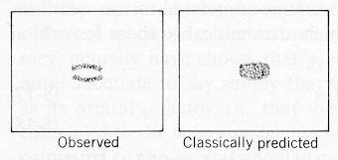
In the absence of magnetc field or in uniform magnetic field
In non uniform magnetic field

